Slide 1
Circuit Synthesis
John F. Wakerly – Digital Design. 4th edition. Chapter 4.
http://www.play-hookey.com
A logic function can be represented in several different forms:
Truth table representation
Boolean equation
Circuit schematic
Map (Karnaugh)
The main goal of hardware synthesis is to create reduced and minimized schematics for these combinational expressions.

Slide 2
Steps of Synthesis
The following steps are a useful formal approach to combinational problems
1. Devise a truth table of the independent input variables and the resulting output quantities.
2. Write Boolean algebra statements that describe the truth table.
3. Reduce the Boolean algebra.
4. Mechanize (implement) the Boolean statements using the appropriate logic gates.

Slide 3
Start the synthesis

Slide 4
Implement

Slide 5
The schematic and timing diagram
A B 0 0 0 1 1 0 1 1 | f(A,B) 1 1 0 1

Slide 6
Timing diagram with delays
Conclusion based on timing analyzes:
The signal change period should be enough longer than the delay time of the gate to be able to take the result after the glitch.

Slide 7
Not minimized circuit

Slide 8
XOR synthesis

Slide 9
XOR implementation
We can begin from the end of circuit creating first the OR gate (“+”)
then creating AND gates
and finally create two invertors to invert the A and B
Or we can begin from the creating initial buses and circuits for Boolean variables A and B
And get their inverted values
Then based on A, B and A’, B’ values create the AND gates.
The last gate will be the OR gate combining both AND gates.

Slide 10
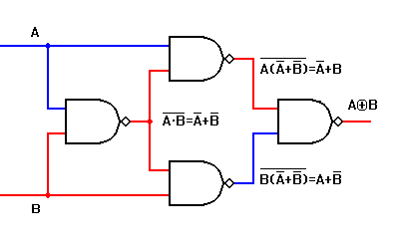
XOR on 2NAND gates

Slide 11
2 functions synthesis
We have a truth table of F1 function of 2 input variables and another truth table of F2 function of 3 input variables.
The problem is to synthesize combinational logic for two functions implementation.

Slide 12
Schematic
BUSes – variable values in form of long lines
They are placed to the leftmost part of schematic
They supply all gates of schematic by variable values.
They have to be enough long to allow gates to be connected by direct lines
The initial buses are the buses only with true values. The false values are derived from the true values by inversion.

Slide 13
Use common parts
Let’s implement another two functions which have the common part.

Slide 14
Use as much common parts as possible

